Slide 1
BIOMOLECULES AND ENZYMES
By – jagu baldwin yash
Division – d
Roll number : 70
(resubmission)

Slide 2
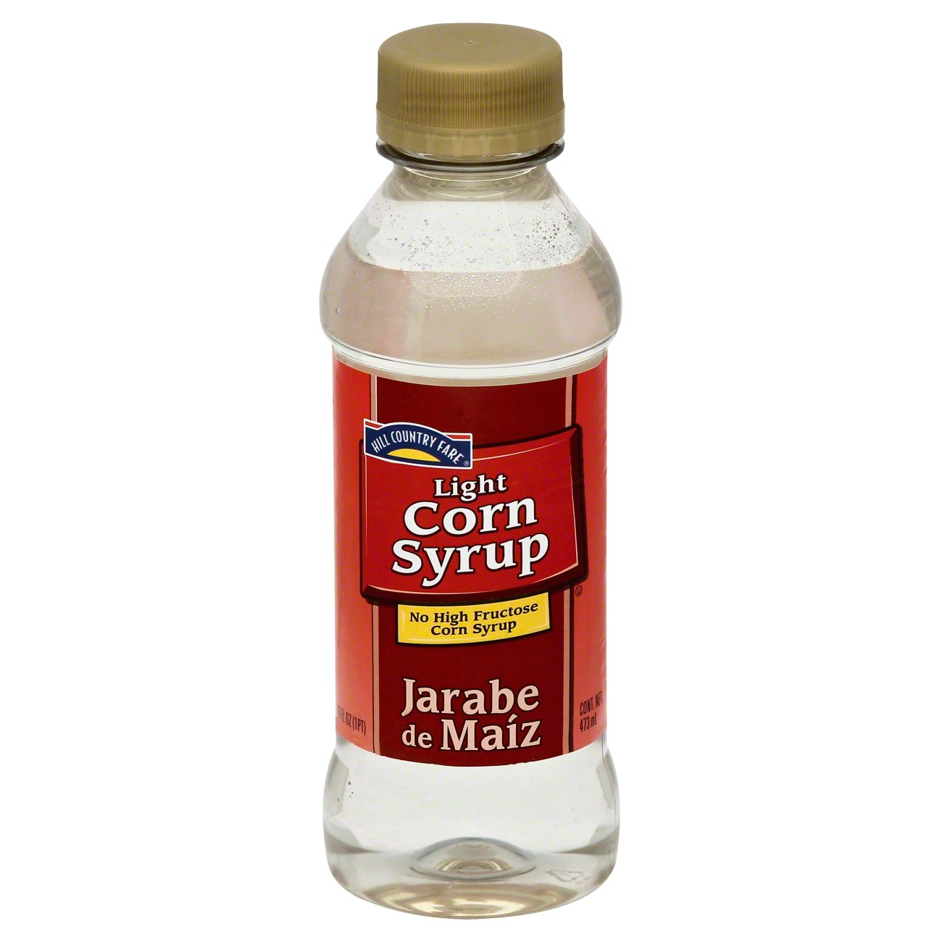
Introduction to Enzyme and Product
Selected Enzyme: Alpha-Amylase
Selected Product: High Fructose Corn Syrup (HFCS)
Company Example: Cargill, a major producer of sweeteners, uses alpha-amylase in their starch hydrolysis process to manufacture HFCS from corn.
Details of the Product: HFCS is a liquid sweetener derived from corn starch, primarily composed of glucose and fructose (e.g., HFCS-55 contains about 55% fructose). It is colorless, viscous, and widely used as a substitute for sucrose in processed foods due to its sweetness and cost-effectiveness.

Slide 3
Role of the Enzyme and Process Conditions
Role of the Enzyme: Alpha-amylase plays a critical role in the liquefaction step of HFCS production by catalyzing the hydrolysis of starch into shorter-chain dextrins and oligosaccharides, breaking down the complex starch molecules from corn into simpler forms that can be further processed into glucose and then fructose.
Process Description: In Cargill's production, corn starch is first milled and formed into a slurry. Alpha-amylase is added to this slurry to liquefy the starch. The mixture is heated, and the enzyme breaks down the starch chains. This liquefied starch is then subjected to further enzymatic treatments (e.g., with glucoamylase and glucose isomerase) to produce HFCS.
Process Conditions: The liquefaction step occurs at a temperature of 95-105°C and a pH of 6.0-6.5, conditions under which thermostable alpha-amylase is effective and stable. The process typically takes place in large industrial tanks with controlled heating and agitation to ensure uniform enzyme activity.

Slide 4
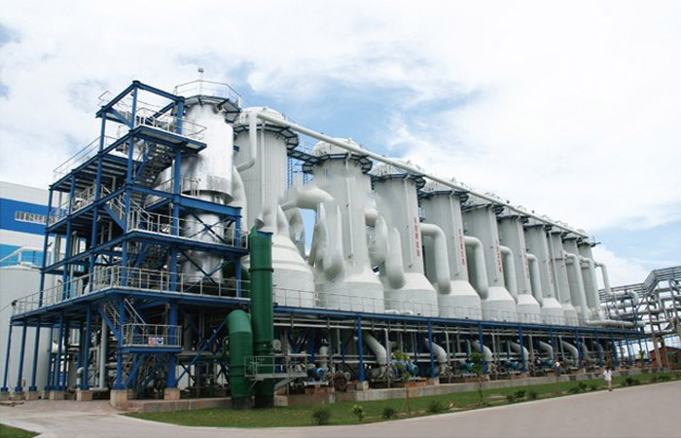
Industrial Applications and My Role
Industrial Applications: HFCS is primarily used in the food and beverage industry, such as in soft drinks, baked goods, and condiments, where it serves as a sweetener.
My Role Based on Branch: As a Computer Engineer, I can contribute by developing automation software for monitoring and optimizing enzyme reaction parameters in real-time during HFCS production, enhancing efficiency through data analysis and predictive modeling.

Slide 5
Reference Slide
https://images.heb.com/is/image/HEBGrocery/000125576-1
https://www.cargill.com/image/1432078643308/hero-isoclear-crust.jpg?v=1482279167000
https://link.springer.com/book/10.1007/978-1-4899-8077-9
https://academicjournals.org/article/article1380113250_Parker%2520et%2520al.pdf
https://www.starchprojectsolution.com/uploads/1805/2-1P505161FHV.jpg
NCERT CHEMISTRY

